Slide 1
Line Pouvaret
BRAIN COMPUTER
INTERFACES

Slide 2
Don’t be mistaken !
BCI :
systems that measure and use signals produced by the CNS
Voice activated communication :
Not a BCI
Muscle-activated communication :
Not a BCI
EEG alone :
Not a BCI (records brain signals)

Slide 3


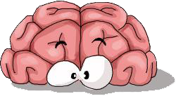
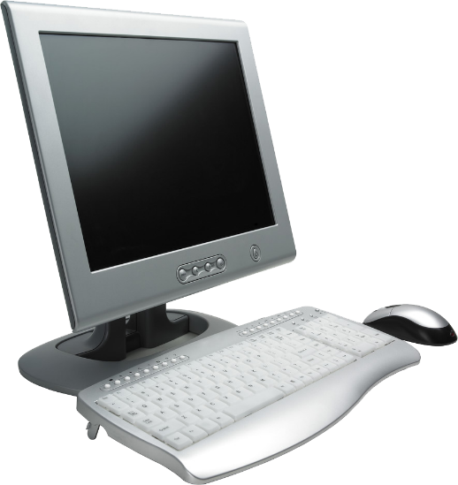

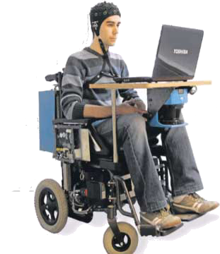
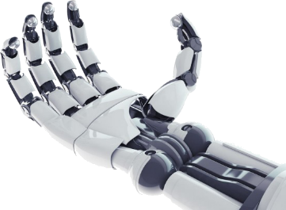
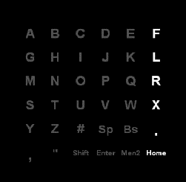
What’s a BCI ?
Definition
Past
Signals
Components
Present
Future
The brain
Sends a signal
The computer acquires and analyzes the signal
Then translates it to commands
The output device executes the desired actions

Slide 4
In the Past
Definition
Past
Signals
Components
Present
Future
1980 : Elbert et al
Control the vertical
movements of a rocket
traveling accross a screen
By 2006 : microelectrode array implanted in a tetraplegic patient
Late 1960s
Early work with Monkeys
1970s :Human investigations
Kuhlman => use of EEG
Wolpaw et al : move a cursor in 1D/2D
1988 : Farwell and Donchin P300
Allows to spell words on a
computer screen
2011 : Krusien-ski and Shih
Signals from the cortical-surface
Allows to accurately spell words

Slide 5
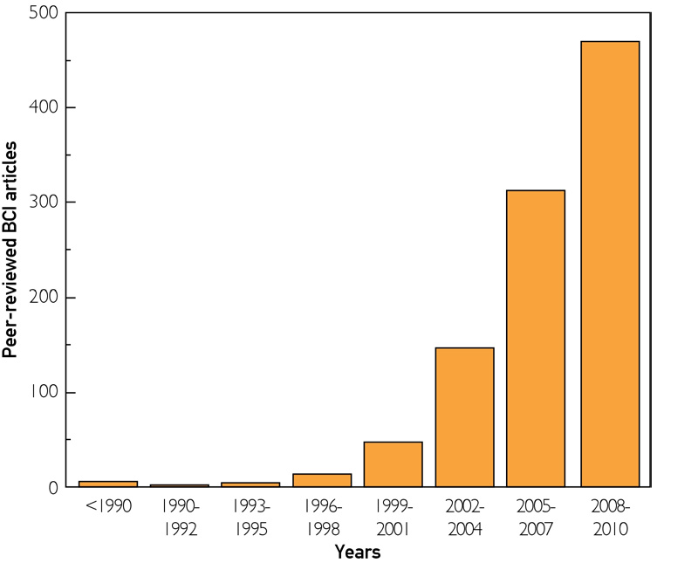
A growing scientific field
Definition
Past
Signals
Components
Present
Future
This graph shows the brain-computer interface articles released in the peer-reviewed scientific literature
BCI research has become an extremely active and rapidly growing scientific field
Adapted from IEEE Trans Neural Syst Rehabil Eng

Slide 6


Signals
Definition
Past
Signals
Components
Present
Future
In principle : any type of brain signal
Most commonly : electrical signals produced by neuronal postsynaptic membrane polarity changes
Early work : scalp EEG (Hans Berger 1929)
safe, easy, inexpensive to acquire
signals attenuated (through dura, skull, scalp)
Small intracortical microarrays
better information recorded
invasive (craniotomy + neurosurgical implantation), restricted area of recording, long-term stability ?

Slide 7
Definition
Past
Signals
Components
Present
Future
ECoG-based BCIs : grid or strip electrodes on the cortical surface
Records intracranially and from larger areas
Neurosurgical implantation, long-term stability ?
So what do we choose ???
Things to consider :
Needs of the individual BCI user
Technological support and resources available

Slide 8
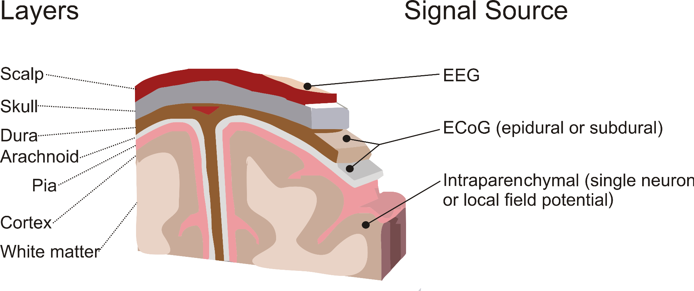
(To resume)
Definition
Past
Signals
Components
Present
Future

Slide 9
Definition
Past
Signals
Components
Present
Future
Also MEG : magnetic fields
2-dimensional BCI task
fMRI, fNIR : blood oxygenation
Correlates with neural activity
Slow response times
These BCI : early phase of research and development
MEG, fMRI : expansive, complicated
Robotic arm with real-time fMRI-based BCI

Slide 10
Components
Definition
Past
Signals
Components
Present
Future
4 sequential components :
1 – Signal acquisition
2 – Feature extraction
3 – Feature translation
4 – Device output
Controlled by an operating protocol

Slide 11
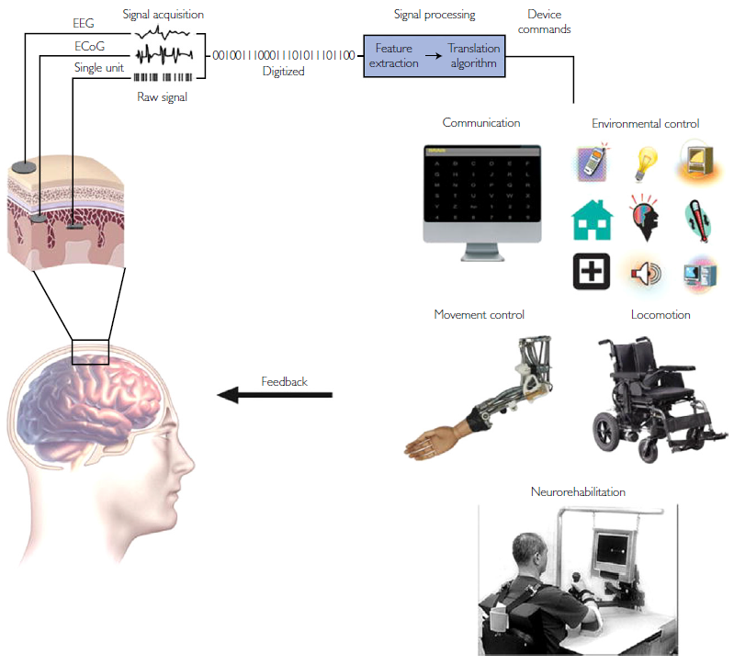
IEEE Rev Biomed Eng21

Slide 12
Definition
Past
Signals
Components
Present
Future
Signal Acquisition
Measurement of brain signals
Signals amplified to levels for electronic processing
+ filter to remove electrical noise
Signal digitized and transmitted
Feature Extraction
Analyze the digital signals
Need to identify the user’s intent
Feature Translation
translation algorithms
Ex : power decrease => upward displacement of cursor
Device ouput
Letter selection, cursor control, robotic arm, etc.
Feedback to the user

Slide 13
Currents BCIs
Definition
Past
Signals
Components
Present
Future
BCIs that use scalp-recorded EEG
Non invasive EEG : most widely research program
Sensorimotors rythms :
1D, 2D, 3D, spelling device, assistive devices, hand orthosis, FES of limbs, robotic/prosthetic devices, wheelchair...
Most famous : P300 speller
Steady-state visual evoked potentials
Binary selection, continuous/discret control of a cursor (2D), prosthetis control, FES, spelling, environment control
Improve of motor function

Slide 14
Definition
Past
Signals
Components
Present
Future
BCIs that use EcoG activity
Implantation of a subdural or epidural electrode array
Higher amplitudes, higher frequency (40-200Hz)
Gamma activity => precision++
Stable over 5 days (for humans), several months (studies with monkeys)

Slide 15
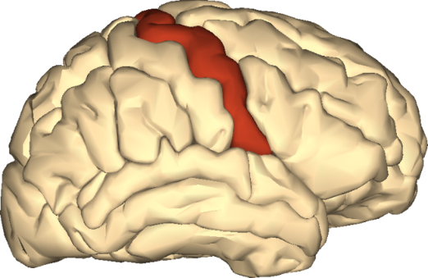
Definition
Past
Signals
Components
Present
Future
BCIs that use activity recorded within the brain
Hochberg et al : clinical trials with 96-electrode microarray implanted in the right precentral gyrus (tetraplegia)
Control of robotic arm, computer cursor, lights, television (imagined arm movements)
Stability++ : 1000 days after implementation
Kennedy et al : intracortical microelectrodes in glass cones
Implanted on a patient with locked-in syndrom (4-year trial)

Slide 16
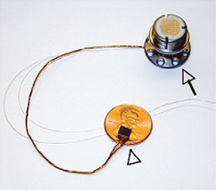
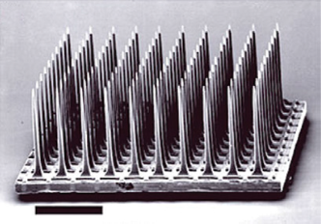
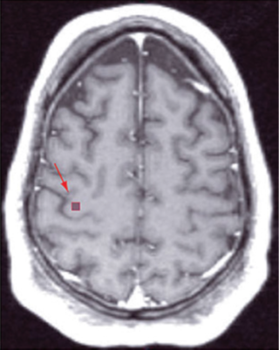
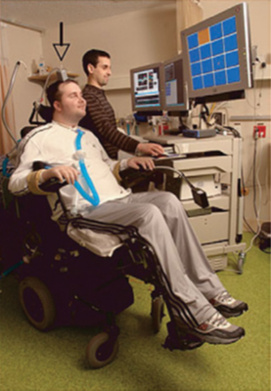
Macmillan Publishers Ltd.: Nature11, 2006.

Slide 17
Status of Research
Definition
Past
Signals
Components
Present
Future
Restore speech by implanting in the speech motor area and decoding phonemes from imagined speech (with ARWB)
Need to move from laboratories to patients home !
Tricky to be implemented : requires engineering, computer science, basic & clinical neuroscience, assistive technology, clinical rehabilitation
Headsets with scalp sensors on the market
Signal not clear, nonbrain signals recorded : not actual BCIs
IntendiX : EEG-based BCI with P300 speller protocol

Slide 18
The Future of BCIs
Definition
Past
Signals
Components
Present
Future
Replace or restore function (people severely disabled)
Improve rehabilitation (strokes, head trauma, etc.)
Problems in 3 critical areas :
Signal-acquisition hardware
BCI validation and dissemination
Reliability

Slide 19
Definition
Past
Signals
Components
Present
Future
Signal-Acquistion Hardware
EEG-bases BCIs : Dry electrodes, small and fully portable, comfort, easy to set up, stability, faculty to adapt, telemetry instead of wiring, interfaces with many apps
BCIs using implanted electrodes :
hardware safe, fully implantable
intact, functional and reliable for decades
Stable signals over the years
Telemetry, batteries
External elements : robust, comfortable, convenient, unobtrusive
Interfaces with high performance apps

Slide 20
Definition
Past
Signals
Components
Present
Future
Validation and dissemination
How good a BCI can get ?
Which are the best ?
Invasive BCIs > Noninvasive BCIs ?
Noninvasive EEG or fNIR based BCIs : basic communication
ECoG/neuron-based BCIs : complex movement control
Validation of BCIs for rehabilitation
Invasive BCIs : expansive => increase number of users, reduce sophistication, insurances

Slide 21
Definition
Past
Signals
Components
Present
Future
Reliability
As reliable as muscle-based actions
Brain signals ⬄ spinal motor neurons
Outputs must correspond to user’s intent
BCI and CNS must work together => reliable partnership in all situations
CNS behaviour : guide for designing BCIs
Use of signals from multiple brain areas
BCI self paced
Sensory feedback : faster, more precise than vision

Slide 22
Conclusion
BCIs were in the realm of science fiction !
Different brain signals, recording methods, signal-processing algorithms
Different devices
Improved life for disabled patients
Major new communication and control technology in the future

Slide 23
Thank you !

